Slide 1
CS 4530
Software Engineering
While everyone is joining, please fill out a brief poll on HW2 at: https://pollev.com/jbell
Lecture 9 - Requirements and User Centered Design
Jonathan Bell, John Boyland, Mitch Wand
Khoury College of Computer Sciences

Slide 2
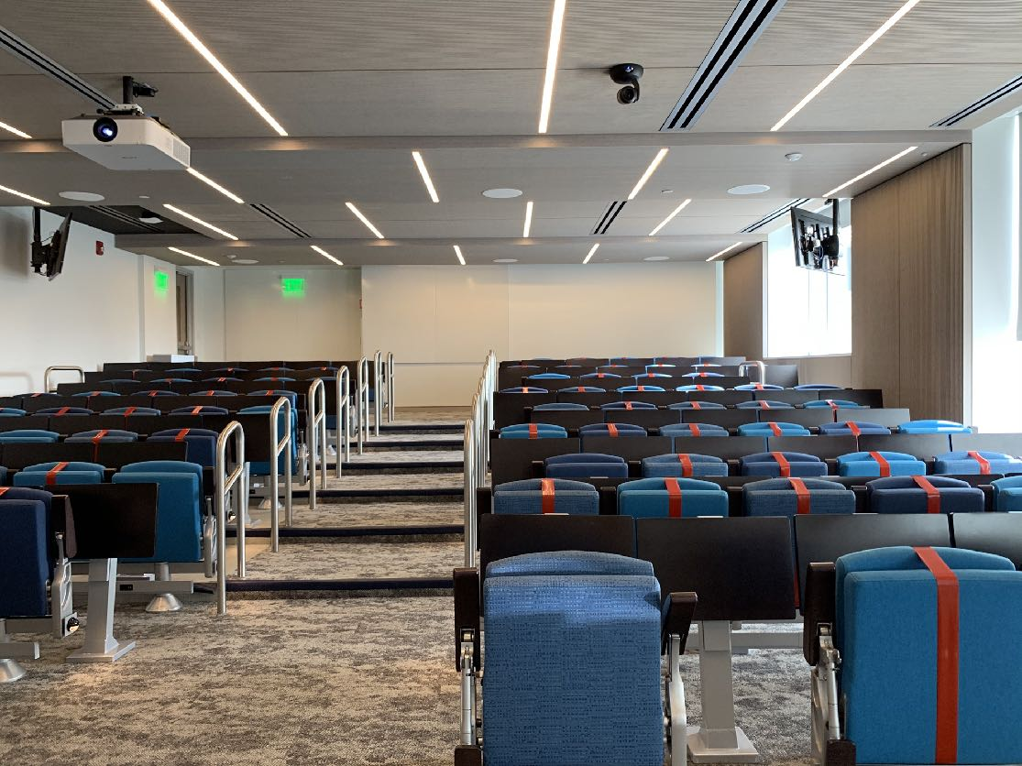
Zoom Mechanics
Recording: This meeting is being recorded
If you feel comfortable having your camera on, please do so! If not: a photo?
I can see the zoom chat while lecturing, slack while you’re in breakout rooms
If you have a question or comment, please either:
“Raise hand” - I will call on you
Write “Q: <my question>” in chat - I will answer your question, and might mention your name and ask you a follow-up to make sure your question is addressed
Write “SQ: <my question>” in chat - I will answer your question, and not mention your name or expect you to respond verbally

Slide 3
Today’s Agenda
Administrative:
HW3, Project pitch due Friday
Today’s session:
Discussion: Conceptual Design Activity: User Centered Design

Slide 4


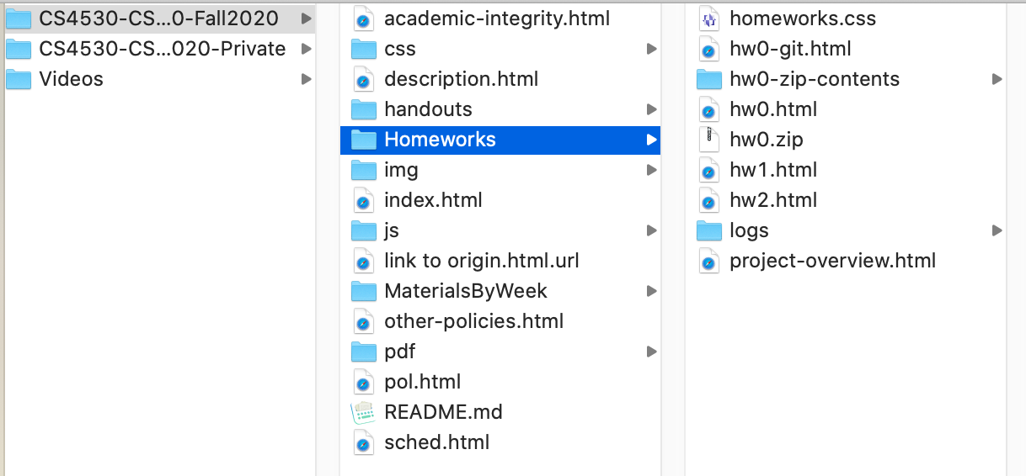
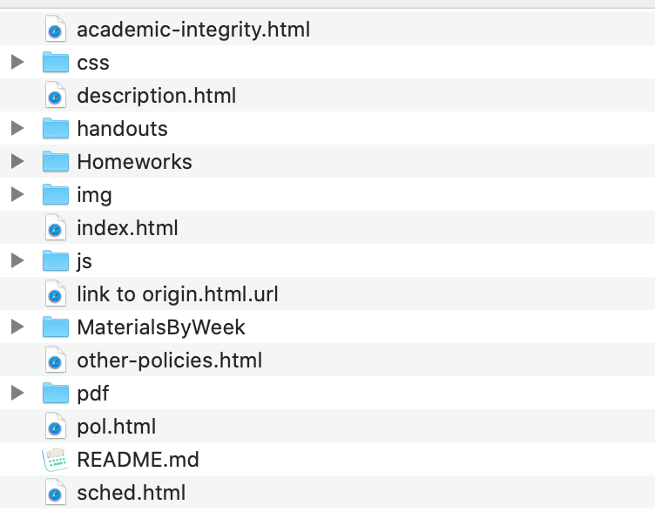

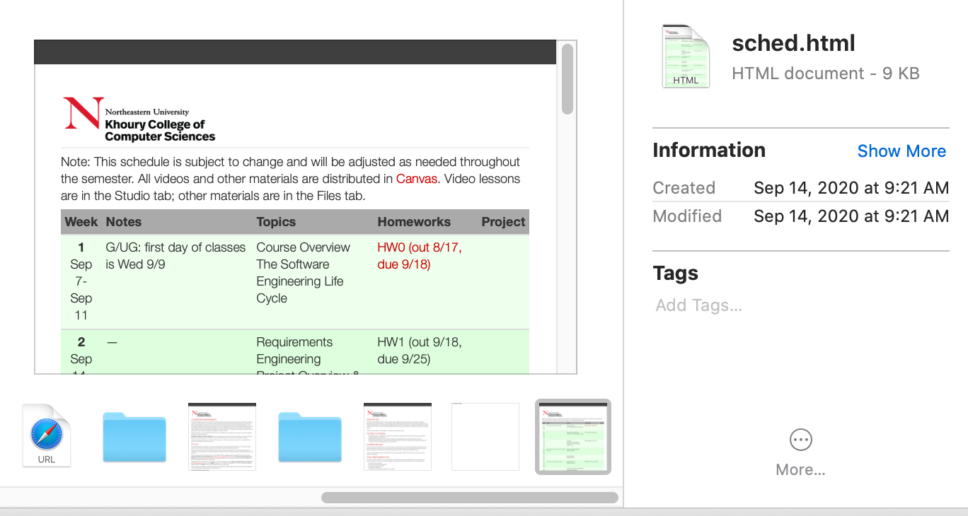

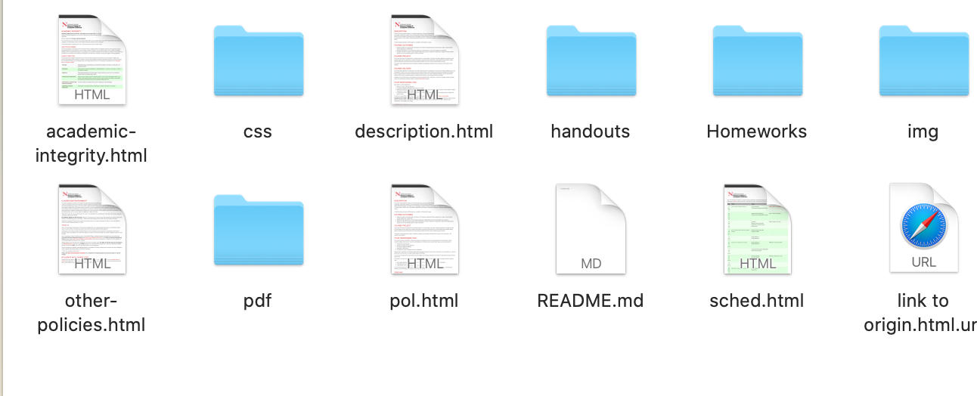
Different Designs for the Same Problem
Key idea: design alternatives

Slide 5
Conceptual Design: Show and Tell
Apple Knowledge Navigator - 1987
Knowledge Navigator Conceptual Video

Slide 6
Design Activity: Covey.Town Rooms Service
Conceptual design: the room metaphor, the user experience
https://neu-se.github.io/CS4530-CS5500-Spring-2021/Activities/activity6-1

Slide 7
This work is licensed under a Creative Commons Attribution-ShareAlike license
This work is licensed under the Creative Commons Attribution-ShareAlike 4.0 International License. To view a copy of this license, visit http://creativecommons.org/licenses/by-sa/4.0/
You are free to:
Share — copy and redistribute the material in any medium or format
Adapt — remix, transform, and build upon the material
for any purpose, even commercially.
Under the following terms:
Attribution — You must give appropriate credit, provide a link to the license, and indicate if changes were made. You may do so in any reasonable manner, but not in any way that suggests the licensor endorses you or your use.
ShareAlike — If you remix, transform, or build upon the material, you must distribute your contributions under the same license as the original.
No additional restrictions — You may not apply legal terms or technological measures that legally restrict others from doing anything the license permits.

